Slide 1
Quarterly Update on the National Inventory Collaborative
December 19, 2018

Slide 2
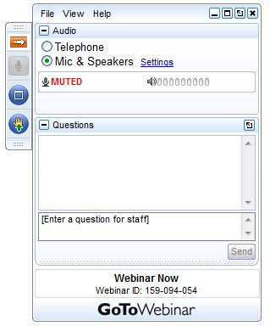
Webinar Ground Rules: Questions?
Each workgroup will give a ~5 minute update describing their work over the last quarter and their plans for the coming months.
All call participants will remain on mute during the webinar.
Type your questions into the question box on the webinar client.
We will try to answer questions at the end of the webinar.
We will create a Q&A document following the webinar and post with the meeting notes on the Collaborative Wiki: http://views.cira.colostate.edu/wiki/wiki/9169

Slide 3
Overview of the Emissions Modeling Platform Collaborative
A new multi-purpose emissions modeling platform (EMP) based on the 2014 National Emissions Inventory version 2 (2014NEIv2) is needed
  State Implementation Plans, federal analyses
  For the first time, EPA, states, and MJOs are engaging in collaborative EMP development
  The 2016 base year was selected via a collaborative process
Future years selected due to regulatory relevance
  2023 is relevant for Ozone NAAQS moderate areas
    2020 will be needed by some states/regions for 2008 O3 NAAQS attainment demonstration modeling
  2028 for regional haze

Slide 4
2016 EMP Schedule
Several versions of 2016 platform will be developed
  Alpha: preliminary version based on 2014NEIv2 for some and 2016 for other key sectors (released March-April, 2018)
    ftp://newftp.epa.gov/Air/emismod/2016/alpha/
    Compatible versions of 2014 and 2015 were also released
    For initial testing of 2016 model runs
  Beta: improved and/or new version of actual 2016 emissions for most sectors and preliminary projected emissions to 2023 and 2028 (January 2019)
  V1.0: fully updated 2016 emissions and complete projected emissions for 2023 and 2028 (Spring 2019)
Schedule overlaps with 2017 NEI Development
  Prioritize the 2017 NEI over the 2016 platform, as needed
  Any missing data for 2016 will be filled in based on 2014 NEI data and nationally consistent methods

Slide 5
Organizational Structure
Coordination co-leads: Zac Adelman (LADCO) and Alison Eyth (EPA OAQPS)
  Developed process and communication structures, facilitate discussions, help resolve issues, documentation requirements, coordinate distribution of data to stakeholders
Coordination committee: regional, state, EPA leaders
  Define processes, resolve issues, co-lead workgroups
  Includes overall and WG co-leads plus MJO directors
Sector-specific Workgroups: one regional/state staff and one EPA staff (where possible)
  Focus on preparing emissions estimates for 2016 and future years, plus improve how the emissions sectors are modeled
  Include participants from EPA/states/locals/regions

Slide 6
Objectives of Today’s Webinar
Provide an update on the schedule for 2016 beta release
Present the plans for the version 1 release, including data updates and schedule

Slide 7
2016 beta Release Schedule
Planned Release Date: January 31, 2019
2016 beta release platform contents
  2016, 2023, and 2028 inventories for all anthropogenic sectors
  2016 inventories for fires
  2016 MEGAN and BEIS3 biogenic emissions on the 12US2 CONUS domain
  SMOKE EMF scripts for 2016 emissions only
  Documentation

Slide 8
Collaborative Workgroup Reports
EGUs
Non-EGU Point
Nonpoint
Oil and gas sources (point and nonpoint)
Onroad
Nonroad
Rail
Commercial Marine Vessels (CMV)
Fires
Biogenics
Modeling
Wrap up
Wiki has more information and notes from each workgroup
  http://views.cira.colostate.edu/wiki/wiki/9169

Slide 9
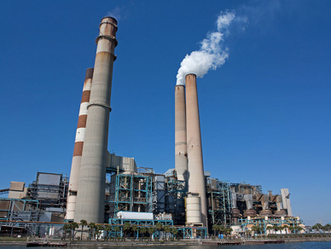
Electricity Generating Units (EGU) Workgroup
Co-leads: Julie McDill (MARAMA), Serpil Kayin (EPA CAMD), Alison Eyth (EPA OAQPS)
Schedule: Calls 4th Thursday at 2:00pm ET
Wiki: http://views.cira.colostate.edu/wiki/wiki/9174

Slide 10
EGU Workgroup: 2016 beta
Base year 2016 is complete
Crosswalks were finalized this quarter to prepare the inventory for platform compatibility with either ERTAC EGU or IPM projections
Temporal allocation for sources without CEMS data uses both peaking and non-peaking sources depending on the type of source

Slide 11
2014 and 2016 EGU Summary
There was a substantial drop in EGU NOx and SO2 from 2014 to 2016
The vast majority of annual EGU emissions are from units with CEMS
Many Non CEMS sources are peaking units

Slide 12
EGU Workgroup: ERTAC-EGU
Runs with new inputs of CONUS v16.0 complete
  Current: v16.0/beta – will be used for 2016 beta platform and 2016v1
  Years:
    Base Year 2016
    Future Years 2020, 2023, 2028
    Other years if needed
  CSAPR-compliant, meets state assurance levels
Next steps
Outreach event January 24 & 29 @ 2PM Eastern (Identical)
  Jan 24 Registration URL: https://attendee.gotowebinar.com/register/8372829819162903042
  Jan 29 Registration URL: https://attendee.gotowebinar.com/register/4154319263223578114
Use the crosswalk to separate base year files into three files:
  ERTAC EGU / Small EGU / NonEGU point
Documentation

Slide 13
EGU Workgroup: IPM
EPA has generated November 2018 IPM v6 Reference Case projections including unit level parsed and flat file outputs for 2023 and 2030 (maps to 2028)
The unit-level emissions are currently being reviewed
The November 2018 IPM v6 Reference Case, updated NEEDS DB and full-fledged documentation will be posted by the end of January 2019
EPA is working on visualizing ERTAC and IPM projections to present in January 2019 EGU WG call
Updated data will be available from:
  https://www.epa.gov/airmarkets/clean-air-markets-power-sector-modeling
No changes for v1 are planned at this time

Slide 14
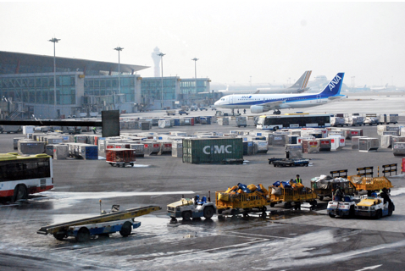
Non-EGU Point Workgroup
Co-leads: Tammy Manning (NC DEQ), Caroline Farkas (EPA)
Schedule: Calls on 3rd Tuesday at 2:00pm Eastern
Wiki: http://views.cira.colostate.edu/wiki/wiki/9177

Slide 15
Non-EGU Point Workgroup
Beta base year is finalized
  ~22,000 facilities reported for 2016
  Remainder pulled forward from 2014
Projections (beta) in progress:
  Working to finalize growth and control packets for beta
  Consent Decrees nearly finalized
  AZ Regional Haze updated 2 facilities
  NC had extension for Boiler MACT rule – received that data in December and are determining if we can include for beta
  Closures updated for some states
  Fuel-combustion projections using AEO 2018 factors
  Aircraft projected to 2023/2028

Slide 16
Non-EGU Point Workgroup: 2016v1
Approach
  Aircraft emissions with new FAA model (AEDT) will be for 2017. We will possibly “backcast” these to 2016.
  Ask member states to submit additional data
  Incorporate MARAMA growth and control tool
Differences from beta
  Base Year (2016): aircraft emissions updated using AEDT model
  Projection Years (2023 & 2028): will include updated data from states (AZ regional haze, closures, NC Boiler MACT, etc), additional consent decrees, MARAMA growth and control
Milestones
  Expected review date: March 2019
  Expected release date: April 2019

Slide 17
Non-EGU Point Workgroup
Projections (v1):
  MARAMA growth and control tool will be used in v1 to update MARAMA states, and possibly to update some subsectors for other states
  If member states have growth or controls that should be handled differently for their state, we are asking for submissions by Jan 30th
  As we receive the 2017 aircraft emissions, we will work with Aircraft subgroup to determine the need to backcast (apply a factor to go back one year)
  There are additional consent decrees that we do not have unit data for yet, we are working with states to estimate these for v1

Slide 18
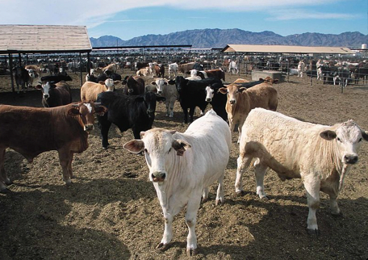
NonPoint
Workgroup
Co-leads: Caroline Farkas (EPA), Jennifer Snyder (EPA)
Schedule: Calls on 4th Monday at 2:00pm Eastern
Wiki: http://views.cira.colostate.edu/wiki/wiki/9178

Slide 19
Nonpoint Workgroup
Beta base year is finalized
  Ag livestock projected to 2016 using county-level data as available
  RWC projected to 2016 using MARAMA’s projection tool
  Population-based activity data updated to 2016
Projections (beta) in progress:
  Working to finalize growth and control packets for beta
  Afdust: unpaved roads – no growth (holding constant)
  Population grown using Woods & Poole data
  Updating industrial sources projections using AEO 2018 factors

Slide 20
Nonpoint Workgroup: 2016v1
Approach
  Incorporate updated projection factors for Ag Livestock when USDA releases new report in Feb 2019
  Afdust:open burning will incorporate a better urban/rural split for v1 – not finalized yet
  Working with states to get state-based population projections
  Incorporate MARAMA growth and control tool
Differences from beta
  Base Year (2016): Afdust open burning improvements
  Projection Years (2023 & 2028): some updated state-based population projections, Ag Livestock updated growth factors, MARAMA growth and control
Milestones
  Expected review date: March 2019
  Expected release date: April 2019

Slide 21
Nonpoint Workgroup
Projections (v1):
  USDA Feb 2018 release did not have 2028 projected for Ag Livestock, we hope to use the 2028 projections that should be released in Feb 2019
  We are working with states to get state-based population projections for 2023/2028 to improve the resolution of pop-based subsectors
  Afdust: open burning – NEI group is working to improve estimation methods but it is not finalized yet. We will work to incorporate their new methods (changes to urban/rural splits) into v1 to reduce the magnitude of over/underpredictions.
  MARAMA growth and control tool will be used in v1 to update MARAMA states, but we may also use it to update some subsectors if we feel it can be applied nation-wide

Slide 22

Oil & Gas
Workgroup
Co-leads: Jeff Vukovich (EPA), Tom Moore (WESTAR and WRAP)
Schedule: Calls on 2nd Monday at 2:00pm Eastern
  Additional Projection Methodology(ies) Subgroup calls
Wiki: http://views.cira.colostate.edu/wiki/wiki/9180

Slide 23
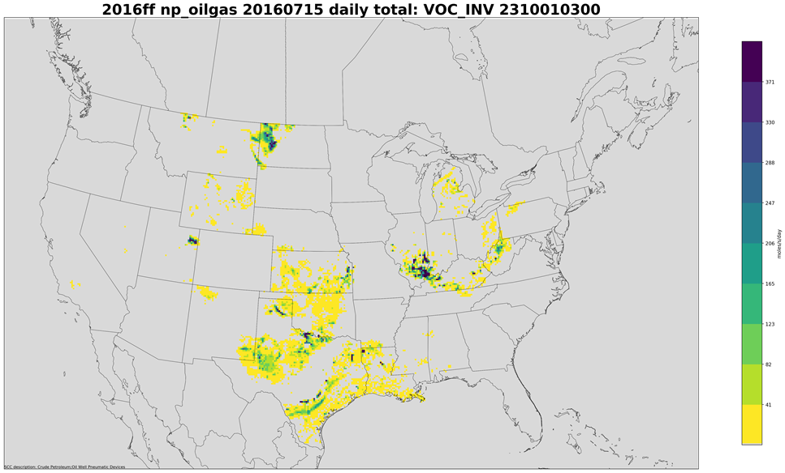
Oil and Gas Workgroup: 2016 beta summary
Base year
  EPA Oil and Gas Tool used for base year, non-point emissions
    State-submitted data/technical direction from CA, CO, OK, and PA
  Oil and Gas point source inventory consists of year 2016 and 2014 emissions
    Year 2014 sources projected to year 2016
  New gridding surrogates and monthly profiles
Future year projections (2023 and 2028)
  Finalizing growth method for 2016 beta soon
    Includes use of AEO 2018 forecasts, historical state information and historical exploration data
  Finalizing control factors (e.g. NSPS)
    Dependent on growth factors above
    Other control “packets” being
    examined/refined

Slide 24
Oil and Gas Workgroup: 2016v1
Approach
  Quality assure 2016beta and make improvements for base year, where possible
  Explore new methods for future-year projections
Differences from beta
  Base Year (2016):
    Any state-submitted changes after 2016beta QA
    Ancillary data changes after 2016beta QA
    WRAP survey input
  Projection Years (2023 & 2028):
    New growth approach for exploration sources
    Possible higher spatial resolution than Supply Region/state
    Further control measure updates
Milestones
  Expected review date: March 2019
  Expected release date: April 2019

Slide 25
Oil and Gas Workgroup
Projections (v1):
  Exploration sources
    Use historical drilling and active wells data for 2011-2017 to better estimate future-year emissions
  Higher spatial resolution projections
    2016beta = Supply Region/state level
    2016v1 = possibly down to basin, county or other scale
  Move to AEO2019 forecasts to be released in early 2019?
  Workgroup to evaluate estimated 2016beta controls
    Possible refinements/changes
    Investigate separating out sources on tribal lands (federally regulated)

Slide 26
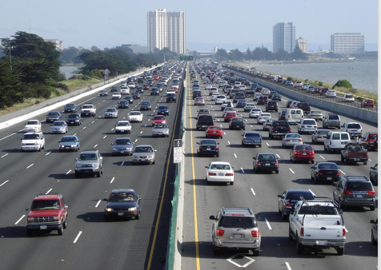
Onroad Mobile Workgroup
Co-leads: Julie McDill (MARAMA), Alison Eyth (EPA OAQPS)
Schedule: Calls 3rd Thursday at 2:00pm ET
Wiki: http://views.cira.colostate.edu/wiki/wiki/9181
Summary reports and maps for beta:
  ftp://newftp.epa.gov/Air/emismod/2016/beta/reports/onroad/

Slide 27
Onroad Workgroup: Beta Summary
About a dozen state and local agencies submitted activity data for 2016, 2023, and 2028
  EPA allocated submitted activity to SCCs and projected activity for remaining areas
EPA ran SMOKE-MOVES to produce emissions for 2016, 2023, and 2028
  MOVES 2014NEIv2 input databases were reconfigured to 2016, 2023, and 2028 and used to create emission factors
  2016 meteorology and spatial surrogates
Onroad data summaries, maps, and state-specific zip files of inventories are available:
  ftp://newftp.epa.gov/air/emismod/2016/beta/reports/onroad/

Slide 28
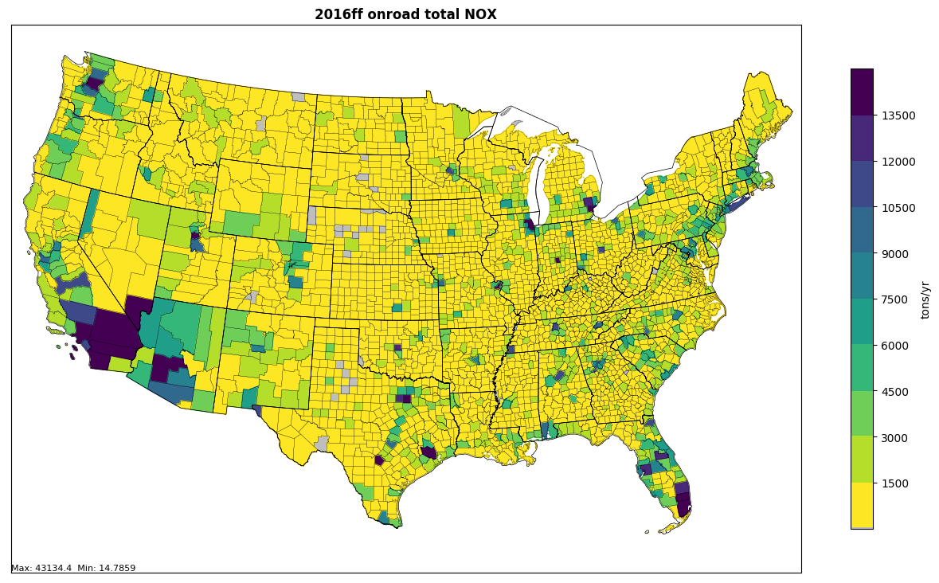
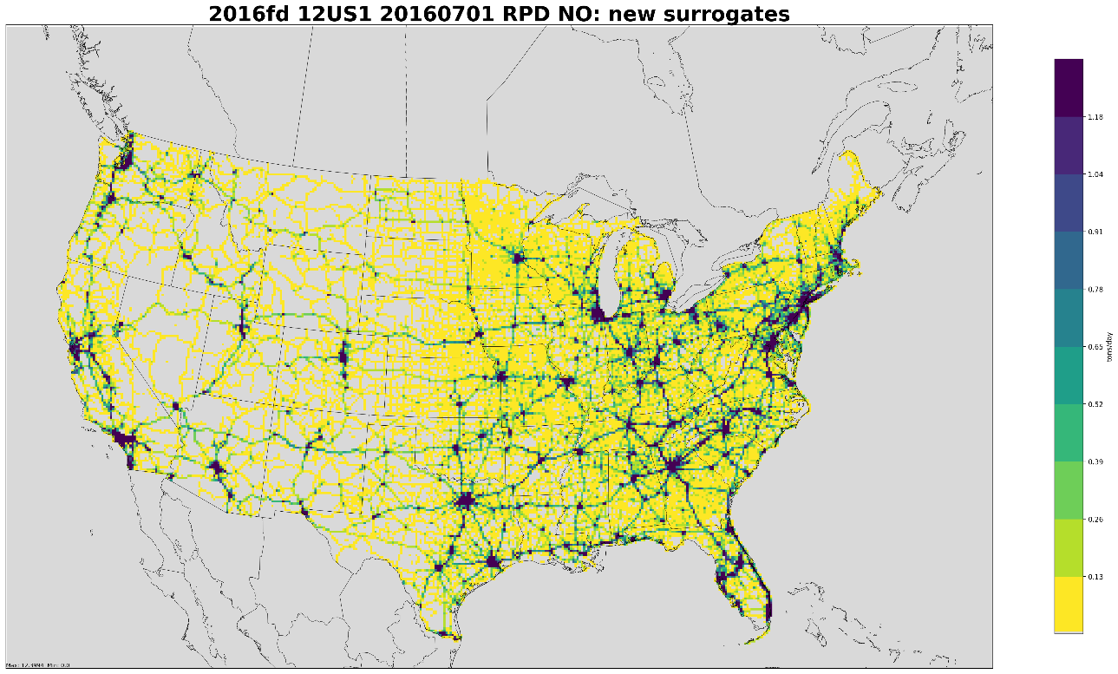
2016 beta Onroad Mobile
Annual NOx Emissions
Total Onroad NOx by county
NOx tends to be highest in urban areas and along interstates
12-km Gridded On-roadway NOx
The 12km gridded data used for modeling visibly resolves interstates and smaller highways

Slide 29
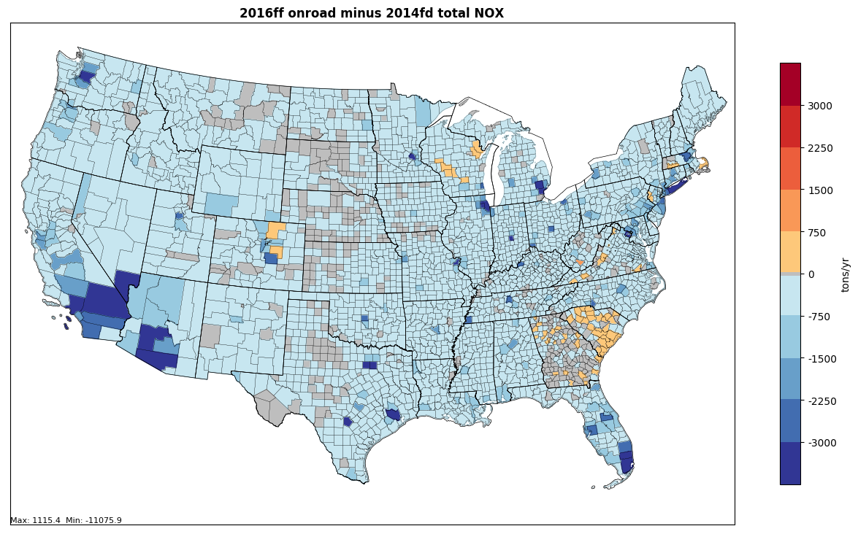
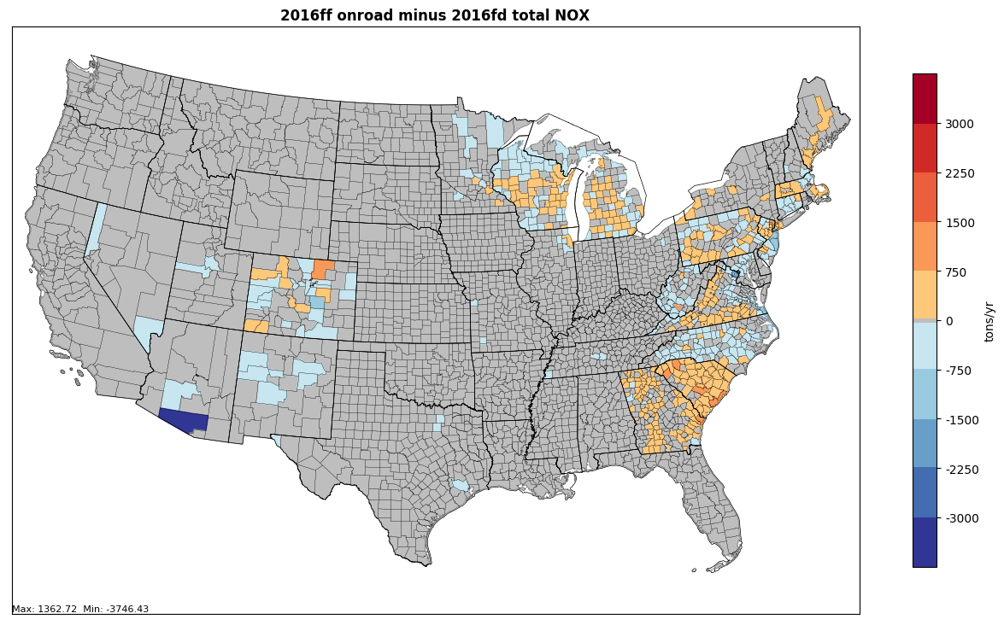
Onroad NOx Emissions Differences
2016 beta is lower than 2014NEIv2 in most areas except where there were substantial changes in activity data
Beta minus 2014 (tons)
Beta minus alpha (tons)
2016 beta is similar to 2016 alpha except where new activity data were used

Slide 30
Comparison of 2016 Beta Onroad Emissions to 2011 Platform Cases
2016 onroad emissions lower than 2011
Beta 2023 and 2028 slightly higher than 2011 platform versions
Impacts vary by state
2011 platform cases: 2011en, 2023en, and 2028el
Beta cases: 2016ff, 2023ff, and 2028ff

Slide 31
2016 Beta Continental US Onroad Emissions Compared to 2011v6.3
Pollutant | 2011en | 2016ff | 2023en | 2023ff | 2028el | 2028ff
CO | 25,981,557 | 20,330,093 | 11,300,137 | 14,251,351 | 8,272,641 | 10,427,337
NH3 | 120,859 | 100,841 | 82,106 | 87,246 | 82,341 | 83,631
NOX | 5,707,939 | 4,065,540 | 1,785,898 | 1,953,938 | 1,292,791 | 1,353,757
PM10-PRI | 336,423 | 272,770 | 239,200 | 224,706 | 230,700 | 211,037
PM25-PRI | 188,925 | 130,564 | 79,527 | 78,910 | 64,135 | 63,041
SO2 | 28,195 | 27,547 | 12,114 | 12,397 | 11,638 | 11,547
VOC | 2,713,181 | 1,985,763 | 987,796 | 1,195,488 | 733,956 | 885,883

Slide 32
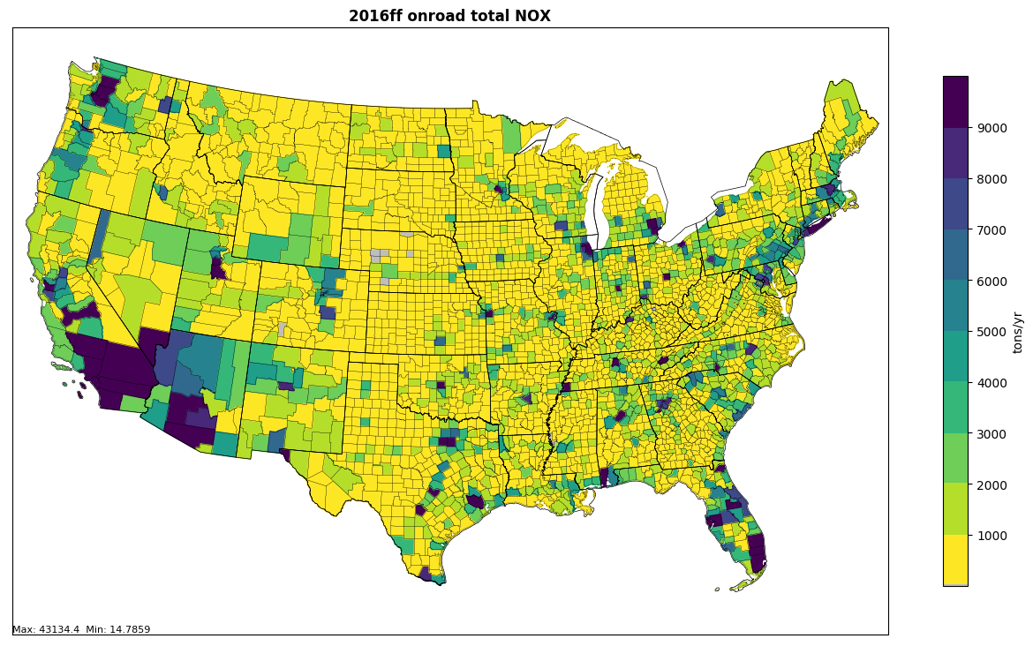
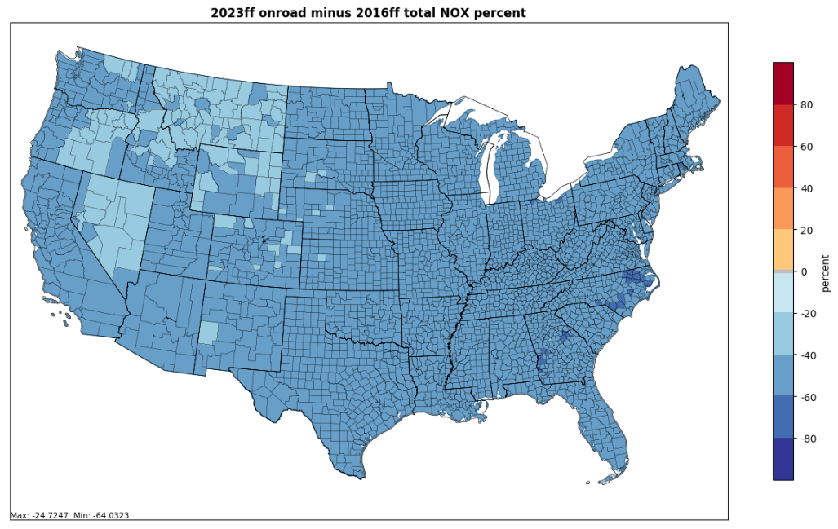
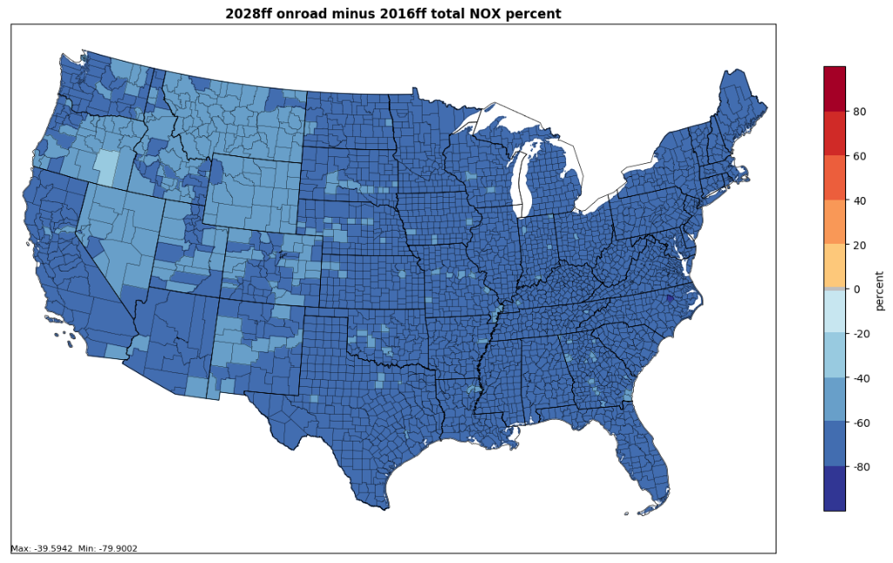
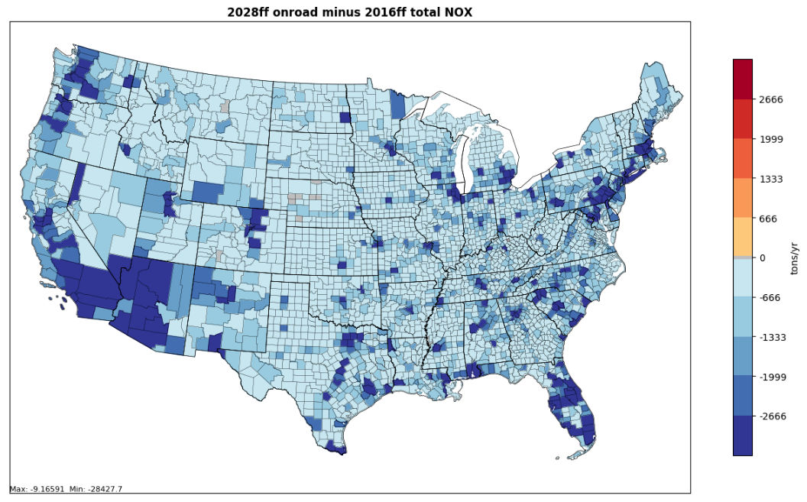
2016 Onroad NOx to 2023 and 2028
2016
2023-2016 (%)
2028-2016 (%)
2023-2016

Slide 33
Onroad Workgroup: Path to 2016v1
Approach
  Vehicle age distributions to be updated to represent 2016 based on CRC VIN decode project for 2017 NEI
  Representative counties will be reviewed
  MOVES will be run to create new emission factors
  SMOKE-MOVES will be run with the new emission factors with some activity updates to create emissions
Differences from beta
  Updated inputs will result in impacts at the state and county levels
2016v1 Milestones for base and future years
  Submit any other updated data for v1 by January 31, 2019
  Expected review date: March-April 2019
  Expected release date: May 2019

Slide 34
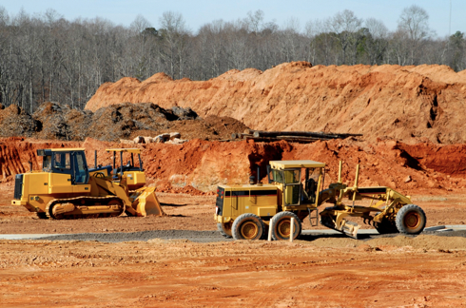
Nonroad Mobile Workgroup
Co-leads: Rebecca Simpson (Colorado Department of Public Health and Environment), Sarah Roberts (EPA OTAQ)
Schedule: Calls on 4th Thursday at 3:30pm Eastern
Wiki: http://views.cira.colostate.edu/wiki/wiki/9179
Status of the 2016 Beta Inventory: newly-released MOVES2014b will be used to generate the beta nonroad inventory and projections.

Slide 35
Beta Nonroad Emissions vs 2011v6.3 Platform
Pollutant | 2011en | 2016ff | 2023en | 2023ff | 2028el | 2028ff
CO | 14,245,158 | 11,089,466 | 12,868,773 | 11,154,989 | 13,433,875 | 11,526,892
NH3 | 2,656 | 1,822 | 3,263 | 2,005 | 3,478 | 2,076
NOX | 1,646,173 | 1,102,956 | 866,679 | 741,087 | 753,557 | 615,637
PM10-PRI | 164,594 | 110,458 | 85,502 | 73,747 | 73,120 | 60,761
PM25-PRI | 156,710 | 104,500 | 80,118 | 69,058 | 68,160 | 56,546
SO2 | 4,119 | 2,243 | 2,409 | 1,556 | 2,527 | 1,573
VOC | 2,065,518 | 1,175,789 | 1,201,558 | 892,850 | 1,156,628 | 839,719
For beta, MOVES2014b run “out of the box” without
state-specific custom inputs

Slide 36
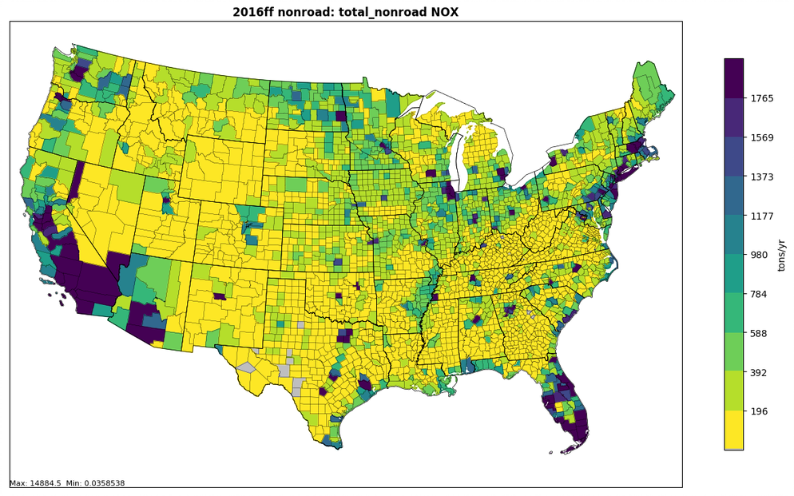
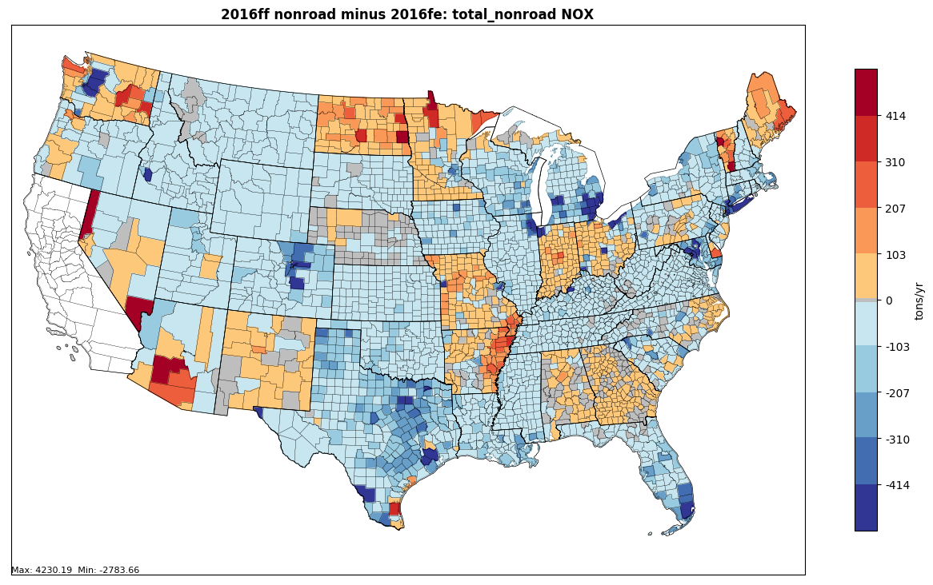
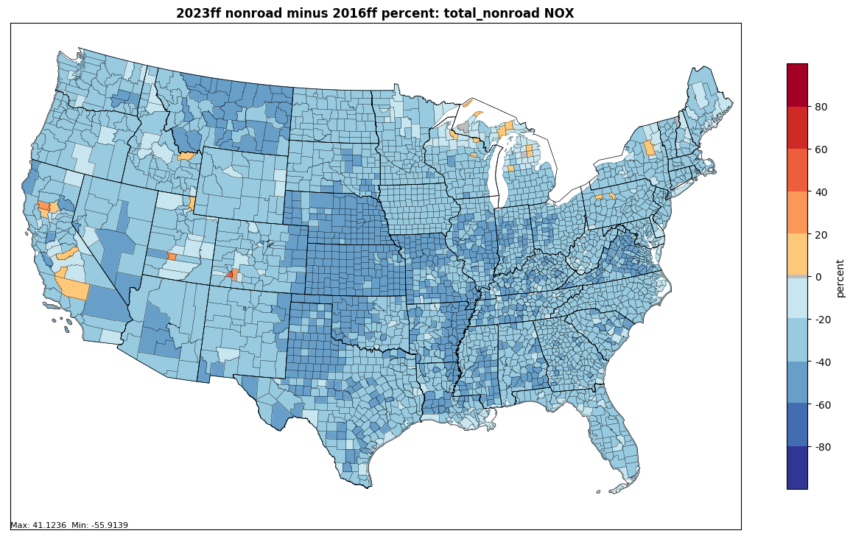
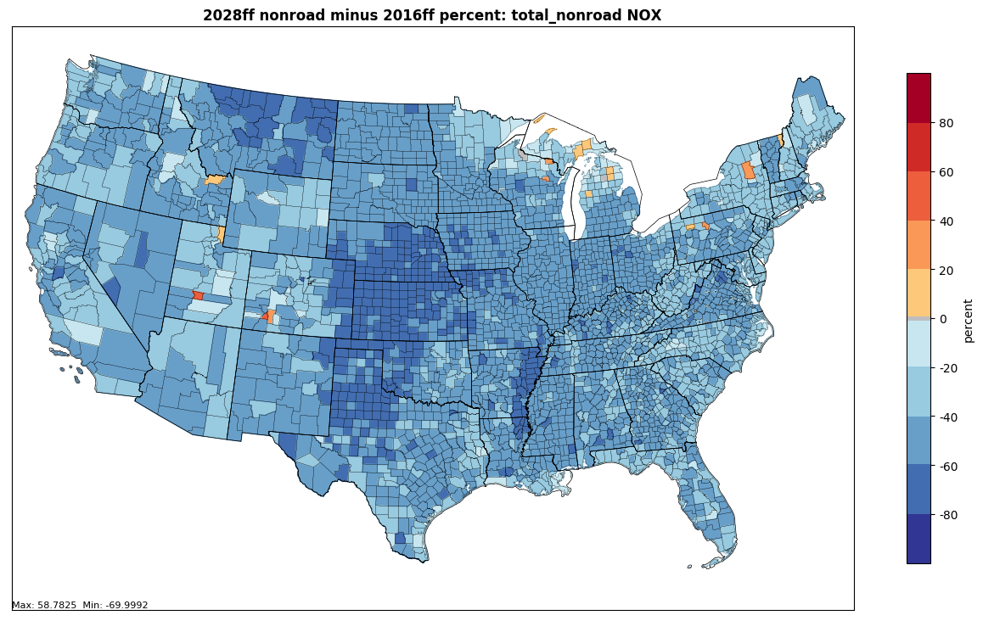
Nonroad NOx: beta versus alpha
2016 beta nonroad NOx
2016 beta minus alpha (tons)
Beta 2023-2016 NOx (%)
Beta 2028-2016 NOx (%)

Slide 37
2016 Nonroad NOx Emissions:
Alpha vs. Beta by equipment sector
Agriculture: -6%
Construction: -10%
Lawn & Garden: -2%
Recreational: -42%
Industrial: -4%
Commercial: -22%
Pleasure Craft: -15%
Logging: -7%
Underground Mining: +1%
Railway Maintenance: -10%

Slide 38
Nonroad Workgroup: 2016v1
Approach
  MOVES2014b with state-supplied data and updated factors for allocating national equipment populations to the state and county levels
Differences from beta
  Updated geographic allocations for Construction and Agricultural equipment sectors
  Likely little to no impact on national-scale inventory, as the total population of equipment will be unchanged
  Impacts will be seen at the state and county levels
Milestones
  Expected review date: March 2019
  Expected release date: April 2019

Slide 39
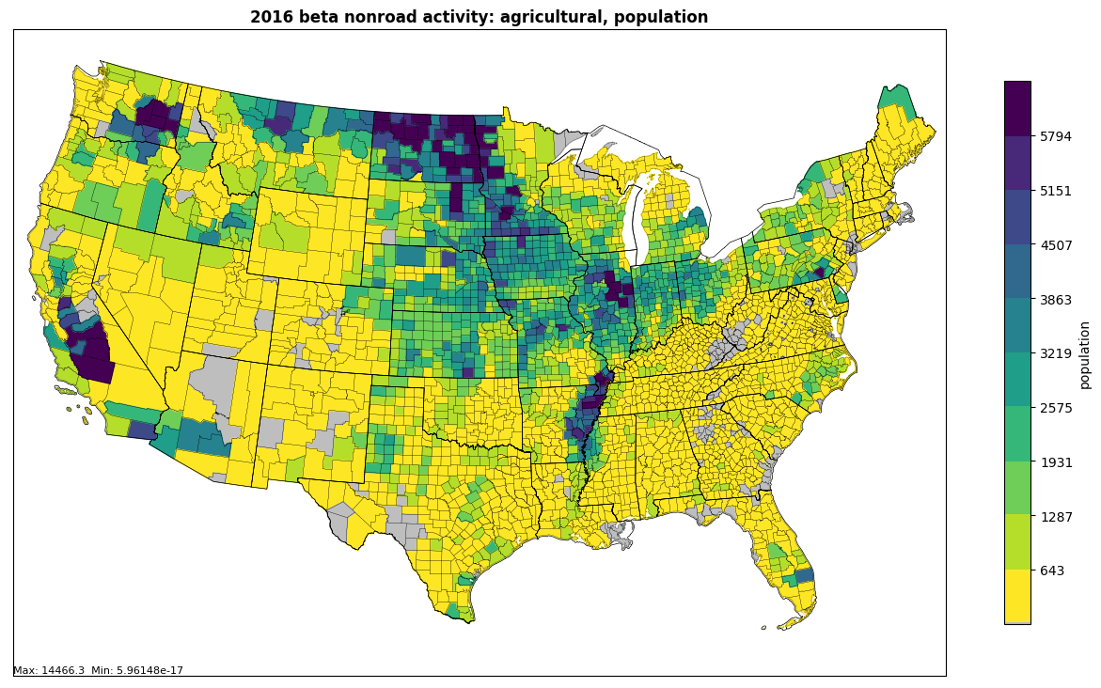
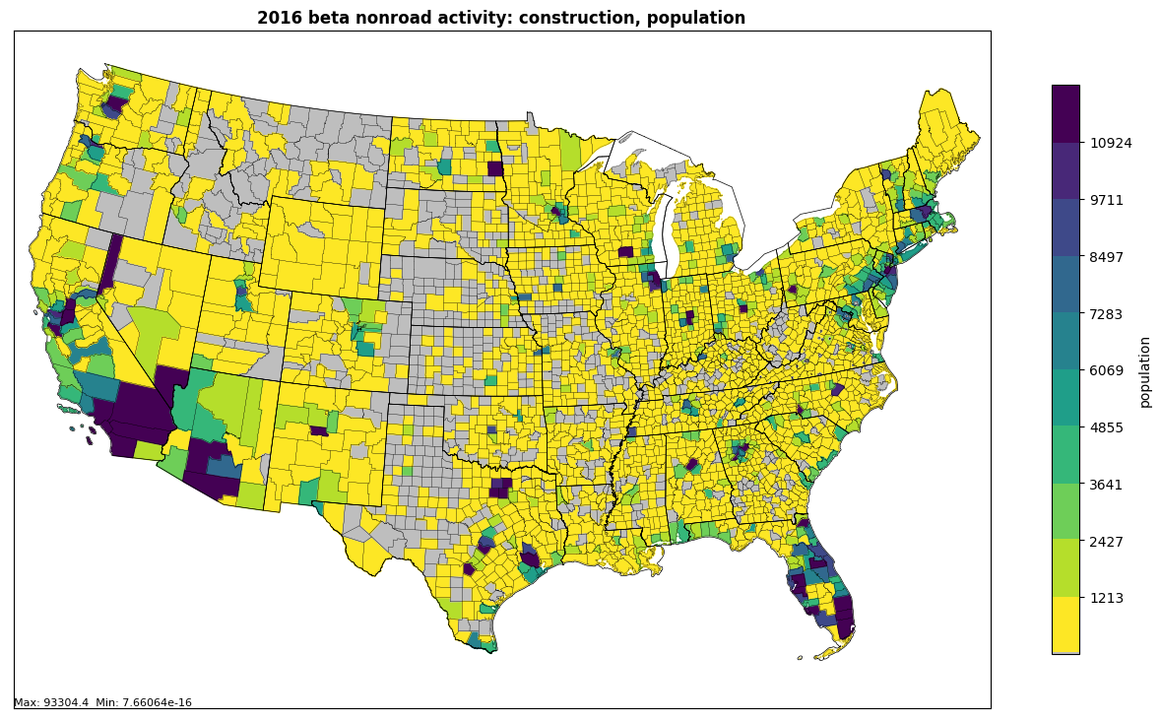
Nonroad Workgroup: 2016v1
Agricultural Equipment
Current methodology | 2002 acres of harvested cropland (USDA Census of Agriculture)
Proposed methodology | 2016 Farm Production Expenditures Summary and 2012 Census of Agriculture’s “Gasoline, Fuels, and Oils Purchased” dollar values (USDA)
Construction Equipment
Current methodology | 2003 total dollar value of construction by county (McGraw-Hill Construction)
Proposed methodologies | 2014 NEI construction dust (acres disturbed); County Business Patterns & Economic Census data for Construction NAICS (U.S. Census)

Slide 40
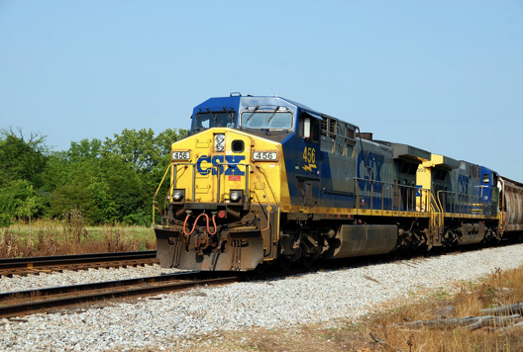
Rail Workgroup
Lead Mark Janssen (LADCO)
Schedule: Calls 3rd Thursday at 11:00am ET
Wiki: http://views.cira.colostate.edu/wiki/wiki/9182

Slide 41
Rail Workgroup: 2016 Beta
Approach
  FRA link level calculation for Line haul.
  Yards, Eastern railroads use Google earth to identify switching engines.
  Includes passenger rail from AMTRACK for the first time
  Includes the larger diesel passenger services in major metro areas (Metra, MBTA, etc)
  Direct to FF10 in spreadsheets and calculation tools.
  Removed 150+ unswitched yards from 2014 estimates

Slide 42
Rail Workgroup: 2016v1
Approach
  Updates from states, including comments on yards, class 2/3 fuel use
  Include better growth estimates of fleet technology
Differences from beta
  Only what states submit.
Milestones
  Expected review date: March 2019
  Expected release date: April 2019

Slide 43
Rail Workgroup: 2016v1
Projections (v1):
  Very low growth rates <5% by 2023.
  Last EPA projection of future technology done by OTAQ in 2008.
  New engines not entering fleet as quickly as expected. Will need improvement

Slide 44
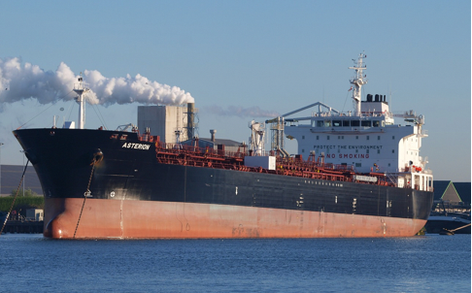
Commercial Marine Vessel (CMV) Workgroup
Lead Mark Janssen (LADCO)
Schedule: Calls 3rd Tuesday at 3:00PM ET
Wiki: http://views.cira.colostate.edu/wiki/wiki/9176

Slide 45
Marine Workgroup: 2016 Beta and v1
Approach for beta
  Project 2014NEIv2 to 2016, 2023, 2028 based on fuel usage and accounting for post 2014 regulations
Approach for v1
  Backcast 2017 NEI to 2016.
  NEI2017 based on new power model and AIS data
  Don’t have data or resources needed to calculate 2016 directly (proprietary vessel data)
  Need a summary of 2017 emission rates by vessel type to proceed

Slide 46
Marine Workgroup: 2016 Beta and v1
V1 Differences from beta
  Base year was 2014 without AIS.
  Projection Years (2023 & 2028): will include updated forecasts from EIA.
Milestones
  Expected release date: April 2019
  Work may continue after version 1 if EPA can release summary data.

Slide 47
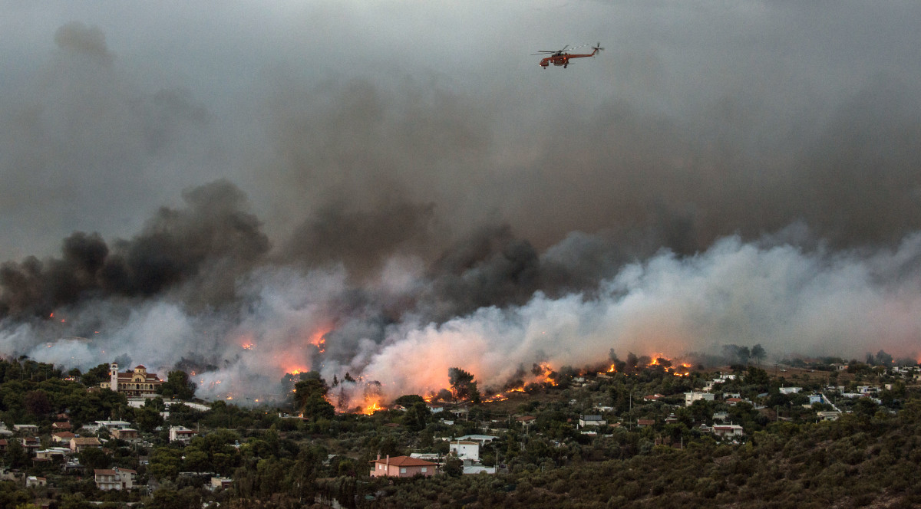
Fires Workgroup
Co-leads: Tom Moore (WESTAR), Jeff Vukovich (EPA)
Schedule: Calls on 1st Thursday 1PM ET
Wiki: http://views.cira.colostate.edu/wiki/wiki/9175
Google Drive: https://drive.google.com/drive/folders/14e4iqUv64z1eC71BHyYPaj09I-kt1MBW
Includes wildfires, prescribed fires and agricultural burns

Slide 48
Fire Emissions Processing at High-Level for non-NEI year
2016 alpha
USDA Cropland Database
HMS Detects
Ag land and grassland detects
Non-ag and non-grassland detects
ICS-209
GeoMAC
Crop residue burning and Grassland fire methodology (USEPA)
SmartFire2
BlueSky Framework
Day-specific Ag burn and grassland fire Emissions
Day-specific Wildfire and Prescribed fire Emissions

Slide 49
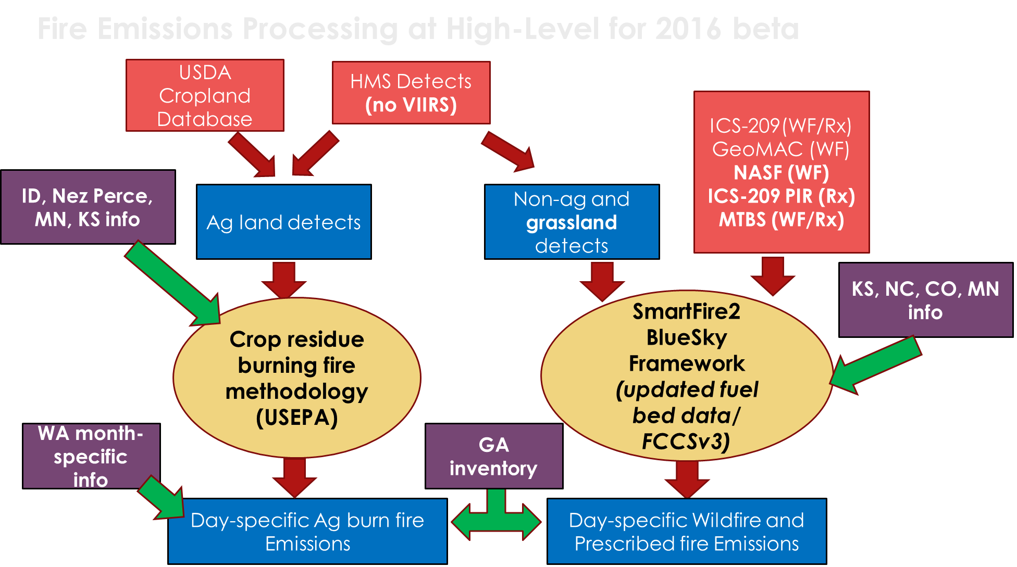
Fire Emissions Processing at High-Level
2016 beta

Slide 50
Fires Workgroup: 2016v1
Approach
  Quality assure 2016beta and make improvements for base year where possible
  Incorporate more national fire information datasets
Differences from beta
  Base Year (2016): Incorporate national fire datasets
    Forest Service Activity Tracking System (FACTS) data from the USFS-USDA
    US Fish and Wildlife Service database
    National Fire Plan Operations and Reporting System (NFPORS) database from Dept of Interior
    Any state-submitted changes after 2016beta QA
    Ancillary data changes after 2016beta QA
  Possible alternative fire scenarios for future year modeling?
Milestones
  Expected review date: March 2019
  Expected release date: April 2019

Slide 51
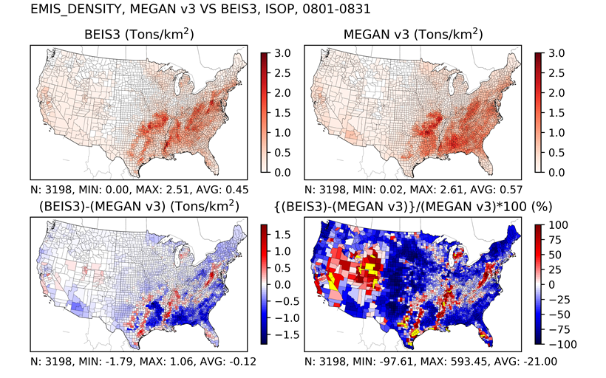
Biogenics Workgroup
Co-leads: Doug Boyer (TCEQ), Jeff Vukovich (EPA)
Schedule: Calls on 3rd Tuesday at 3:30pm Eastern
Wiki: http://views.cira.colostate.edu/wiki/wiki/9172

Slide 52
Biogenics: 2016beta summary
2016 alpha consisted only of a BEISv3.61 simulation
MEGANv3 software made available by TCEQ
TCEQ acquired 2016 MCIP data from USEPA
TCEQ ran MEGANv3 for 2016 using MCIP data
Workgroup did some comparisons vs. BEIS3
Minor water correction made to BELD4 and BEIS3 rerun
BEIS3 (water correction) and MEGANv3 “default” simulations made available for 2016 beta release

Slide 53
Biogenic Workgroup: 2016v1
Approach
  Investigate input data improvements and software/science updates
Differences from beta
  Base Year (2016): possibilities include:
    Land use and other input data changes
    MEGANv3 software update
  Projection Years (2023 & 2028): N/A
Milestones
  Expected review date: March 2019
  Expected release date: April 2019

Slide 54
Biogenic Workgroup
Base year:
  Landuse updates
    Environment Canada Biogenic Emissions Landcover Database (BELD4)
      1km landuse for all of Canada using BELD4 vegetation types
    Western USA landuse updates possible
      USGS Southwest Regional GAP (SWReGAP) Analysis Project: http://swregap.org/
  Software updates
    Possible MEGANv3 update
  Emissions flux evaluation
    Using summer 2013 emissions flux data to compare BEIS3 and MEGANv3

Slide 55
Emissions Modeling Workgroup
Co-leads: Eric Zalewsky (NY DEC), Zac Adelman (LADCO) [Interim]
Schedule: Calls on 4th Thursday at 3:00pm Eastern
Wiki: http://views.cira.colostate.edu/wiki/wiki/9190

Slide 56
Emissions Modeling Workgroup
Scope: To test and help document the emissions modeling platform
  EPA OAQPS will build the beta and v1 modeling platforms
  Workgroup will beta test the platform scripts and release package, document how to change the platform
Currently working on creating standardized emissions summary plots for use in the sector workgroup documentation

Slide 57
International Emissions
Mexico
  Emissions are the same as those in the alpha platform but we hope to have some improvements in time for 2016 v1 via a collaboration with SEMARNAT
Canada
  Beta emissions use a new 2015 inventory from Environment and Climate Change Canada
  A corresponding future year inventory is not yet available so we are using the older 2025 inventory
  We hope that a consistent future year inventory will become available before 2016v1 is finalized

Slide 58
Meteorology and Air Quality Modeling
Emissions and other inputs to the air quality model will be made available via the Intermountain West Data Warehouse (IWDW)
  EPA will share its 2016 meteorological input data for air quality modeling with the IWDW
EPA will be modeling the 2016 beta base year case 2016ff
  EPA does not currently plan to model 2023ff or 2028ff

Slide 59
Inventory Collaborative Next Steps
Complete 2023 and 2028 beta inventories
Complete beta documentation
Workgroups will prioritize their work to produce version 1.0 of the 2016 inventory by spring 2019; including projections to 2023 and 2028
Collect information on prospective uses of the alpha and beta platforms: let us know
Next quarterly outreach call:
April 3, 2019 at 12:00 Eastern

Slide 60
Inventory Collaborative Wiki
These slides, answers to the questions posed during this webinar, notes:
http://views.cira.colostate.edu/wiki/wiki/10195
Main National Inventory Collaborative Wiki includes live workgroup wikis, documentation, calendar:
http://views.cira.colostate.edu/wiki/wiki/9169

